Slide 1
Overview of Computer Networks
Protocols and the TCP/IP Protocol Suite
Mi-Jung Choi
mjchoi@kangwon.ac.kr
Dept. of Computer Science and Engineering
Kangwon National University
Fall 2020

Slide 2
Contents
Three key elements of a PROTOCOL
A Simple Protocol Architecture
OSI reference model
The TCP/IP protocol architecture

Slide 3
OSI Reference Model

Slide 4
OSI
Open Systems Interconnection
Developed by
the International Organization for Standardization (ISO)
Seven layers
A theoretical system delivered too late!
TCP/IP is the de facto standard

Slide 5
OSI - The Model
A layer model
Each layer performs a subset of the required communication functions
Each layer relies on the next lower layer to perform more primitive functions
Each layer provides services to the next higher layer
Changes in one layer should not require changes in other layers

Slide 6
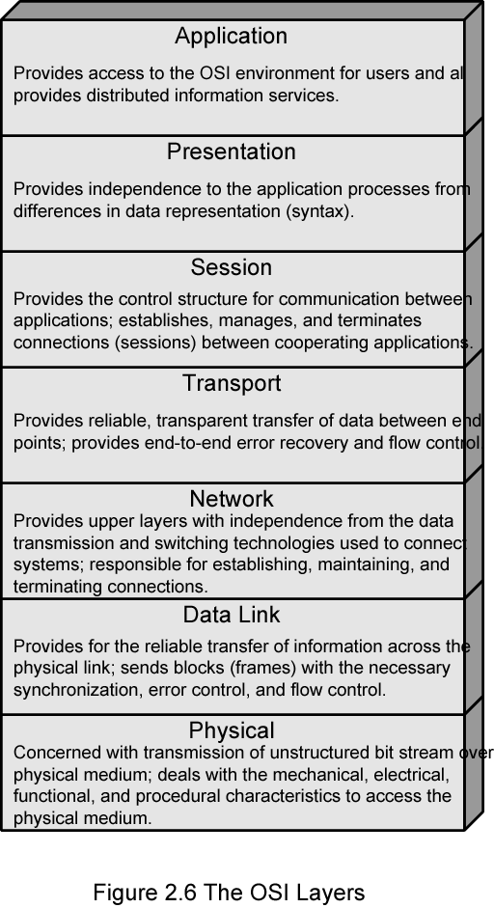
OSI Layers
Integer byte order
FTP (control, data)
TCP 3-way handshaking
TCP
IP

Slide 7
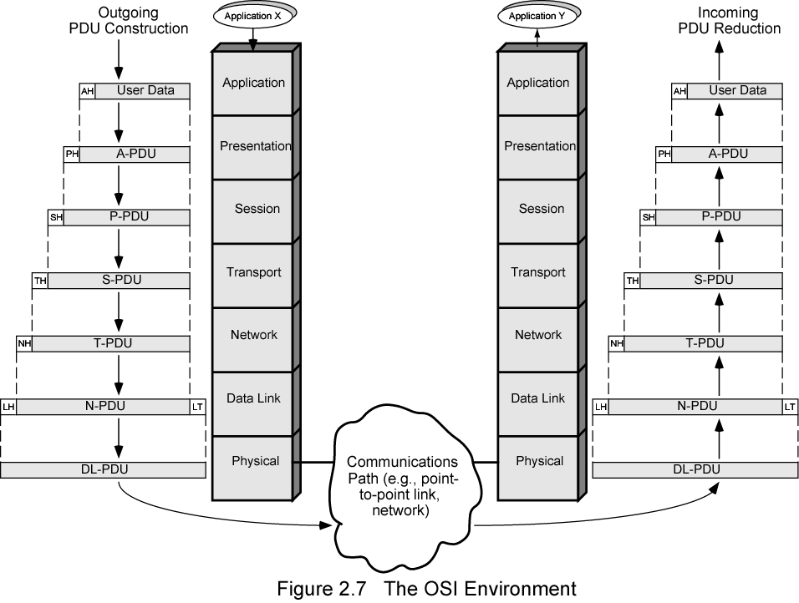
The OSI Environment

Slide 8
TCP/IP Protocol Architecture

Slide 9
TCP/IP Protocol Architecture
Developed by the US Defense Advanced Research Project Agency (DARPA) for its packet switched network (ARPANET)
Used by the global Internet
No official model but a working one.
  Application layer
  Host to host or transport layer
  Internet layer
  Network access layer
  Physical layer
Application Layer
Transport Layer
Internet Layer
Network Access Layer
Physical Layer

Slide 10
Physical Layer
Physical interface between data transmission device (e.g. computer) and transmission medium or network
defines
  Characteristics of transmission medium
  Signal levels
  Data rates
  etc.

Slide 11
Network Access Layer
Exchange of data between end system and network
Destination address provision
Invoking services like priority

Slide 12
Internet Layer (IP)
Systems may be attached to different networks
Routing functions across multiple networks
Implemented in end systems and routers

Slide 13
Transport Layer (TCP)
Reliable delivery of data
Ordering of delivery

Slide 14
Application Layer
Support for user applications
e.g. HTTP, SMPT

Slide 15
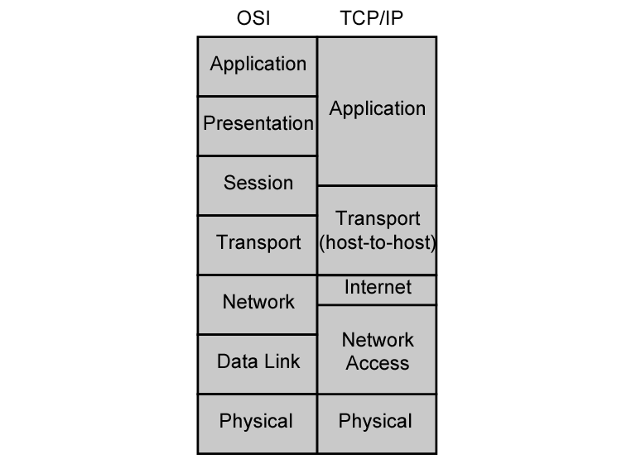
OSI vs. TCP/IP
?
?
Notes:
? – TPC three-way-handshaking connection
? – single network transmission, ex – Ethernet 에서의 routing

Slide 16
TCP
Usual transport layer is Transmission Control Protocol
  Reliable connection
Connection
  Temporary logical association between entities in different systems
TCP PDU
  Called TCP segment
  Includes source and destination port (c.f. SAP)
    Identify respective users (applications)
    Connection refers to pair of ports
TCP tracks segments between entities on each connection

Slide 17
UDP
Alternative to TCP is User Datagram Protocol
Not guaranteed delivery
No preservation of sequence
No protection against duplication
Minimum overhead
Adds port addressing to IP

Slide 18
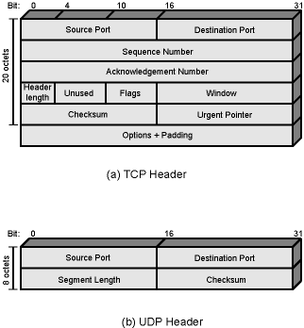
TCP and UDP Headers

Slide 19
IP and IPv6
IP (v4) header minimum 20 octets (160 bits)
32-bit source and destination addresses
Checksum applies to header to avoid incorrect delivery
Protocol field shows if TCP, UDP etc. carried
Flags and fragmentation offset used in fragmentation
1995 IPng became standard IPv6 in 1996
Enhancements for modern high speed networks
Carry multimedia data streams
Increase address space ➔16 octets (128bits)

Slide 20
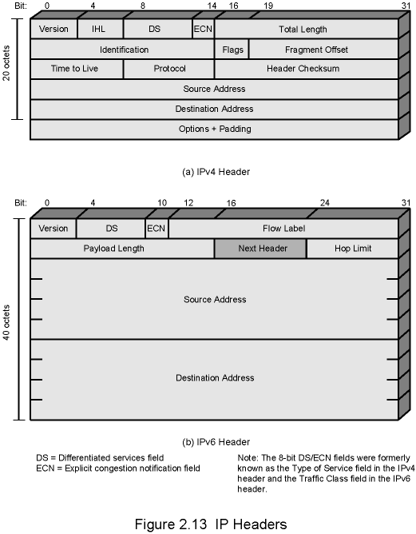
IPv4 Header

Slide 21
IPv6 Header

Slide 22
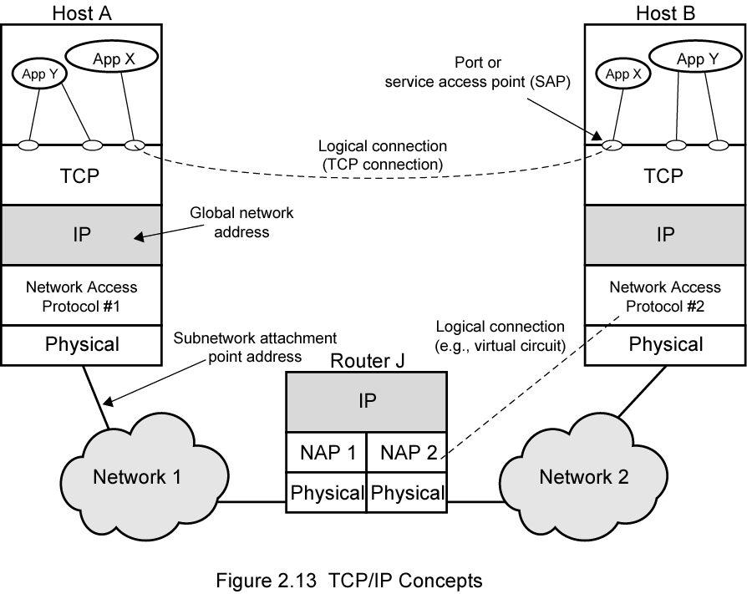
TCP/IP Concepts

Slide 23
Addressing Level
Level in architecture at which entity is named
Unique address for each end system (computer) and router
Network level address
  IP or internet address (TCP/IP)
  Network service access point or NSAP (OSI)
Process within the system
  Port number (TCP/IP)
  Service access point or SAP (OSI)
Application Layer
Transport Layer
Internet Layer
Network Access Layer
Physical Layer

Slide 24
Trace of Simple Operation
Process associated with port 1 in host A sends message to port 2 in host B
Process at A hands down message to TCP to send to port 2
TCP hands down to IP to send to host B
IP hands down to network layer (e.g. Ethernet) to send to router J
Generates a set of encapsulated PDUs

Slide 25
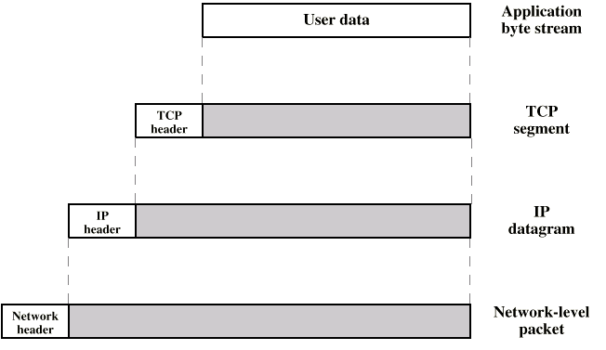
PDUs in TCP/IP

Slide 26

Q & A
Q & A 게시판
Transport Layer
3-<number>

